Slide 1

CSE 5305/4300
Prof. Wei Zhang
November 15, 2025
FIFO Quantum to SJF
Priya Jeyaprakash, Xinyi Li, Zion Jones, Nick Garcia

Slide 2


CPU Schedulers
CPU Schedulers Manage Processes that need to run on the CPU
Good practices for a scheduler are :
Flexibility in CPU Occupation
Fairness
Increased Performance
Notes:
Flexibility - variability in job types - Long vs. short - Interactive vs. non-interactive - I/O-bound vs. compute-bound - Which process (thread) to run, for how long, etc
Fairness - All users should get access to CPU - Amount of CPU should be roughly even?
- no starvation - no deadlock
Goals (Performance metrics) - Minimize turnaround time - avg time to complete a job - Tturnaround = Tcompletion − Tarrival - Maximize throughput - operations (jobs) per second - Minimize overhead of context switches: large quanta - Efficient utilization (CPU, memory, disk etc)
-Short response time - Tresponse = Tfirstrun − Tarrival - type on a keyboard - Small quanta

Slide 3

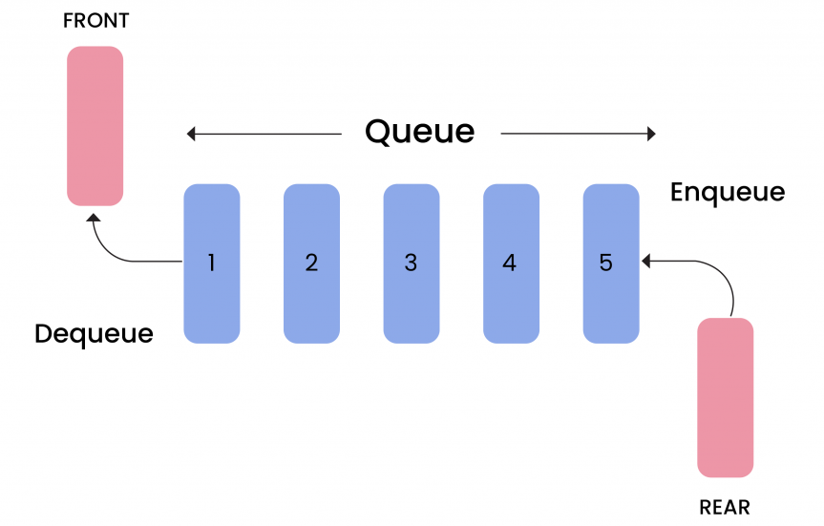
FIFO
First in First Out
Earliest arriving job will execute first, with the subsequent jobs running in the order in which they arrived.
Once a job is started it will complete before CPU is used by another scheduler

Slide 4
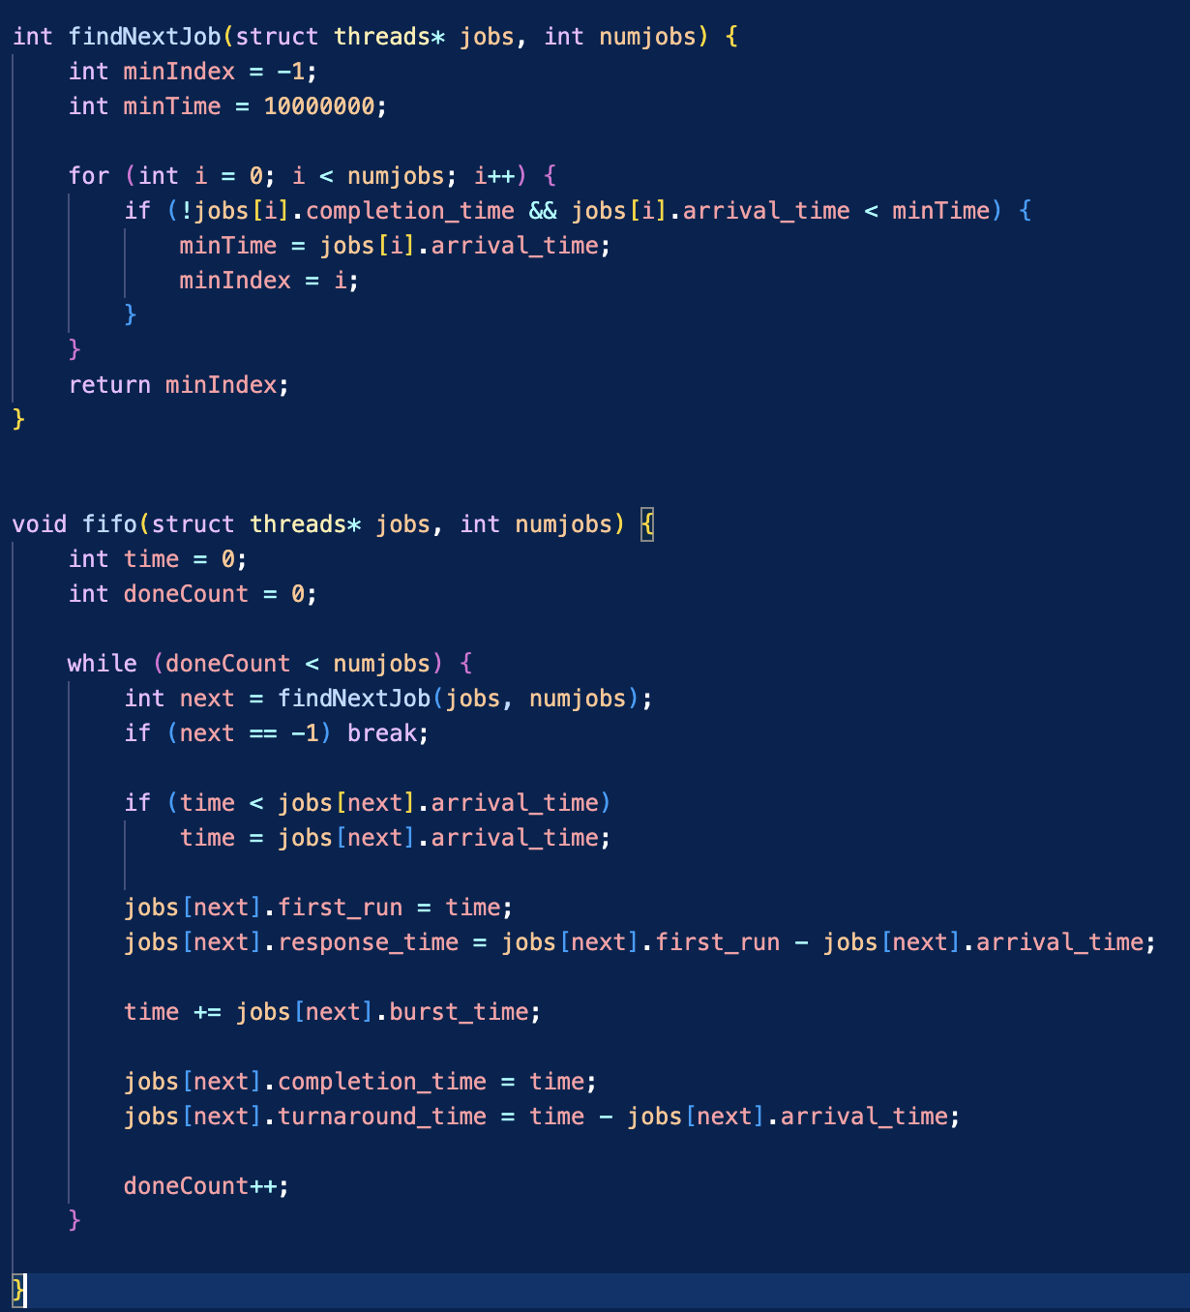
findNextJob()
Function to be used in FIFO to find what job is the next in the arrival queue
Notes:
Flexibility - variability in job types - Long vs. short - Interactive vs. non-interactive - I/O-bound vs. compute-bound - Which process (thread) to run, for how long, etc
Fairness - All users should get access to CPU - Amount of CPU should be roughly even?
- no starvation - no deadlock
Goals (Performance metrics) - Minimize turnaround time - avg time to complete a job - Tturnaround = Tcompletion − Tarrival - Maximize throughput - operations (jobs) per second - Minimize overhead of context switches: large quanta - Efficient utilization (CPU, memory, disk etc)
-Short response time - Tresponse = Tfirstrun − Tarrival - type on a keyboard - Small quanta

Slide 5
FIFO()
FIFO function to be applied onto existing job queue to save CPU processing data
Notes:
Flexibility - variability in job types - Long vs. short - Interactive vs. non-interactive - I/O-bound vs. compute-bound - Which process (thread) to run, for how long, etc
Fairness - All users should get access to CPU - Amount of CPU should be roughly even?
- no starvation - no deadlock
Goals (Performance metrics) - Minimize turnaround time - avg time to complete a job - Tturnaround = Tcompletion − Tarrival - Maximize throughput - operations (jobs) per second - Minimize overhead of context switches: large quanta - Efficient utilization (CPU, memory, disk etc)
-Short response time - Tresponse = Tfirstrun − Tarrival - type on a keyboard - Small quanta

Slide 6
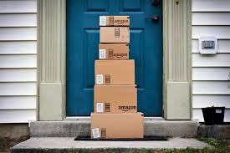
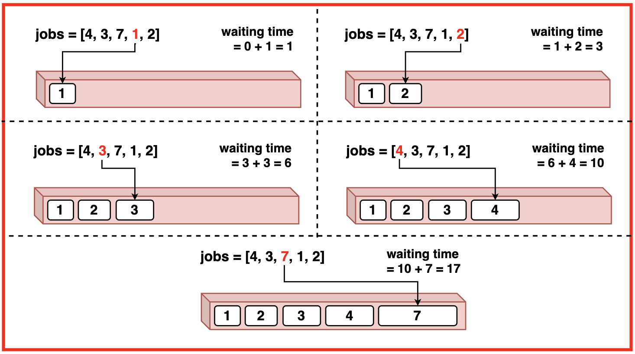
SJF
Shortest Job First
Will pick the shortest arrived job at time of scheduling and execute to completion

Slide 7
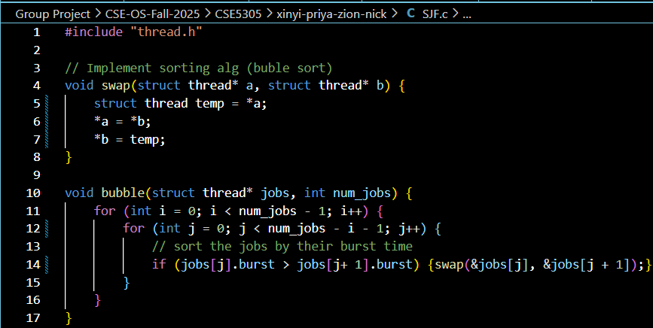
bubble()
Function used by SJF to sort all incoming jobs so it goes in order of shortest to longest using bubblesort algorithm.
swap()
Helper function used in bubble() to implement the bubblesort sorting algorithm.
Notes:
Shortest jobs always go first (short = less CPU time needed) - preemptive vs non preemptive
Fairness - Amount of CPU should be roughly even? --> processes the short jobs that don't require as much CPU first
- no starvation - no deadlock
Goals (Performance metrics) - Minimize turnaround time - avg time to complete a job - Tturnaround = Tcompletion − Tarrival - Maximize throughput - operations (jobs) per second - Minimize overhead of context switches: large quanta - Efficient utilization (CPU, memory, disk etc) --> consider using a different sorting alg for optimization (e.g. heap or merge sort)
-Short response time - Tresponse = Tfirstrun − Tarrival - type on a keyboard - Small quanta

Slide 8
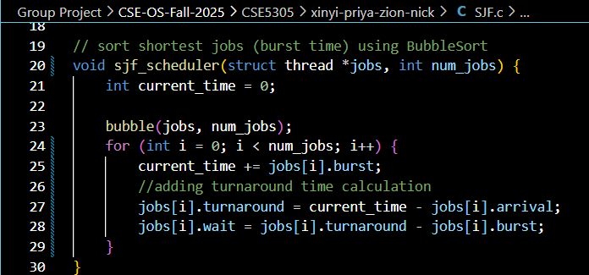
sjf_scheduler()
SJF function to be applied onto existing job queue to save CPU processing data
(e.g. turnaround and wait time)
Notes:
Shortest jobs always go first (short = less CPU time needed) - preemptive vs non preemptive
Fairness - Amount of CPU should be roughly even? --> processes the short jobs that don't require as much CPU first
- no starvation - no deadlock
Goals (Performance metrics) - Minimize turnaround time - avg time to complete a job - Tturnaround = Tcompletion − Tarrival - Maximize throughput - operations (jobs) per second - Minimize overhead of context switches: large quanta - Efficient utilization (CPU, memory, disk etc) --> consider using a different sorting alg for optimization (e.g. heap or merge sort)
-Short response time - Tresponse = Tfirstrun − Tarrival - type on a keyboard - Small quanta

Slide 9
Pros vs. Cons
FIFO
Pros
Easy to understand
Simple to implement
No starvation
No context switching time
Cons
Can have long wait time for big job first
SJF
Pros
Low average turn around time
Cons
Big jobs take a very long time to turn around
Big jobs can be starved
Low predictability
Notes:
Shortest jobs always go first (short = less CPU time needed) - preemptive vs non preemptive
Fairness - Amount of CPU should be roughly even? --> processes the short jobs that don't require as much CPU first
- no starvation - no deadlock
Goals (Performance metrics) - Minimize turnaround time - avg time to complete a job - Tturnaround = Tcompletion − Tarrival - Maximize throughput - operations (jobs) per second - Minimize overhead of context switches: large quanta - Efficient utilization (CPU, memory, disk etc) --> consider using a different sorting alg for optimization (e.g. heap or merge sort)
-Short response time - Tresponse = Tfirstrun − Tarrival - type on a keyboard - Small quanta

Slide 10


Quantum FIFO to SJF
A quantum is a fixed time slice given to a CPU scheduler. In all, it is the maximum continuous time a process or job will be allowed to run before the scheduler pauses it and switches to another process. In our case, the quantum represents the time FIFO is allowed to run before switching to SJF

Slide 11
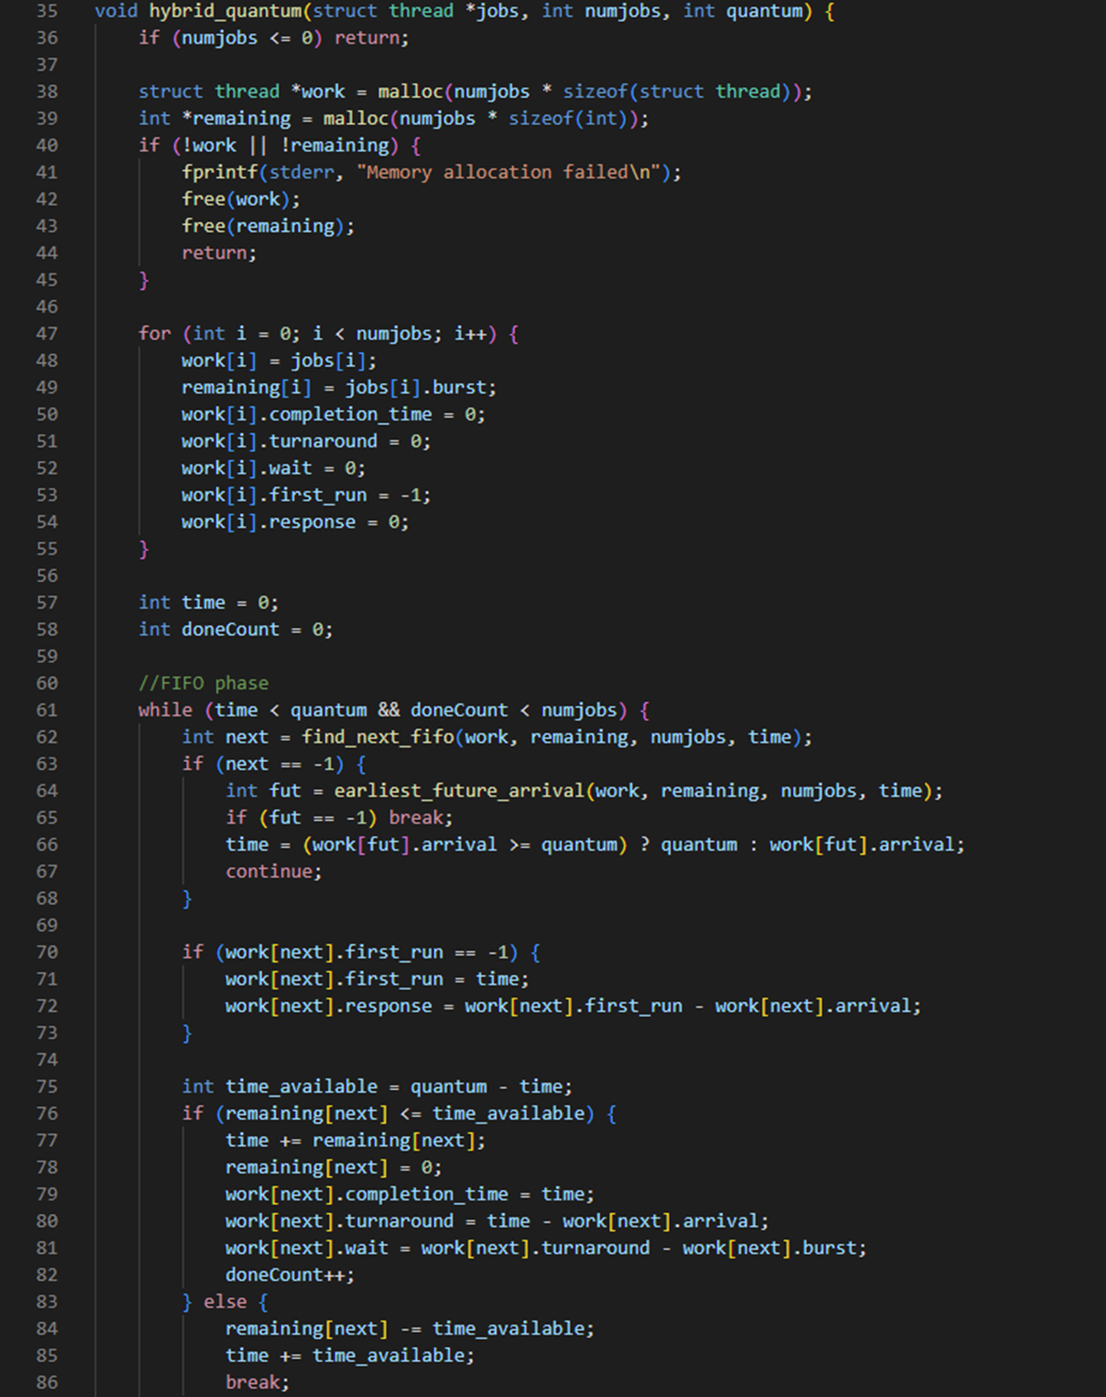
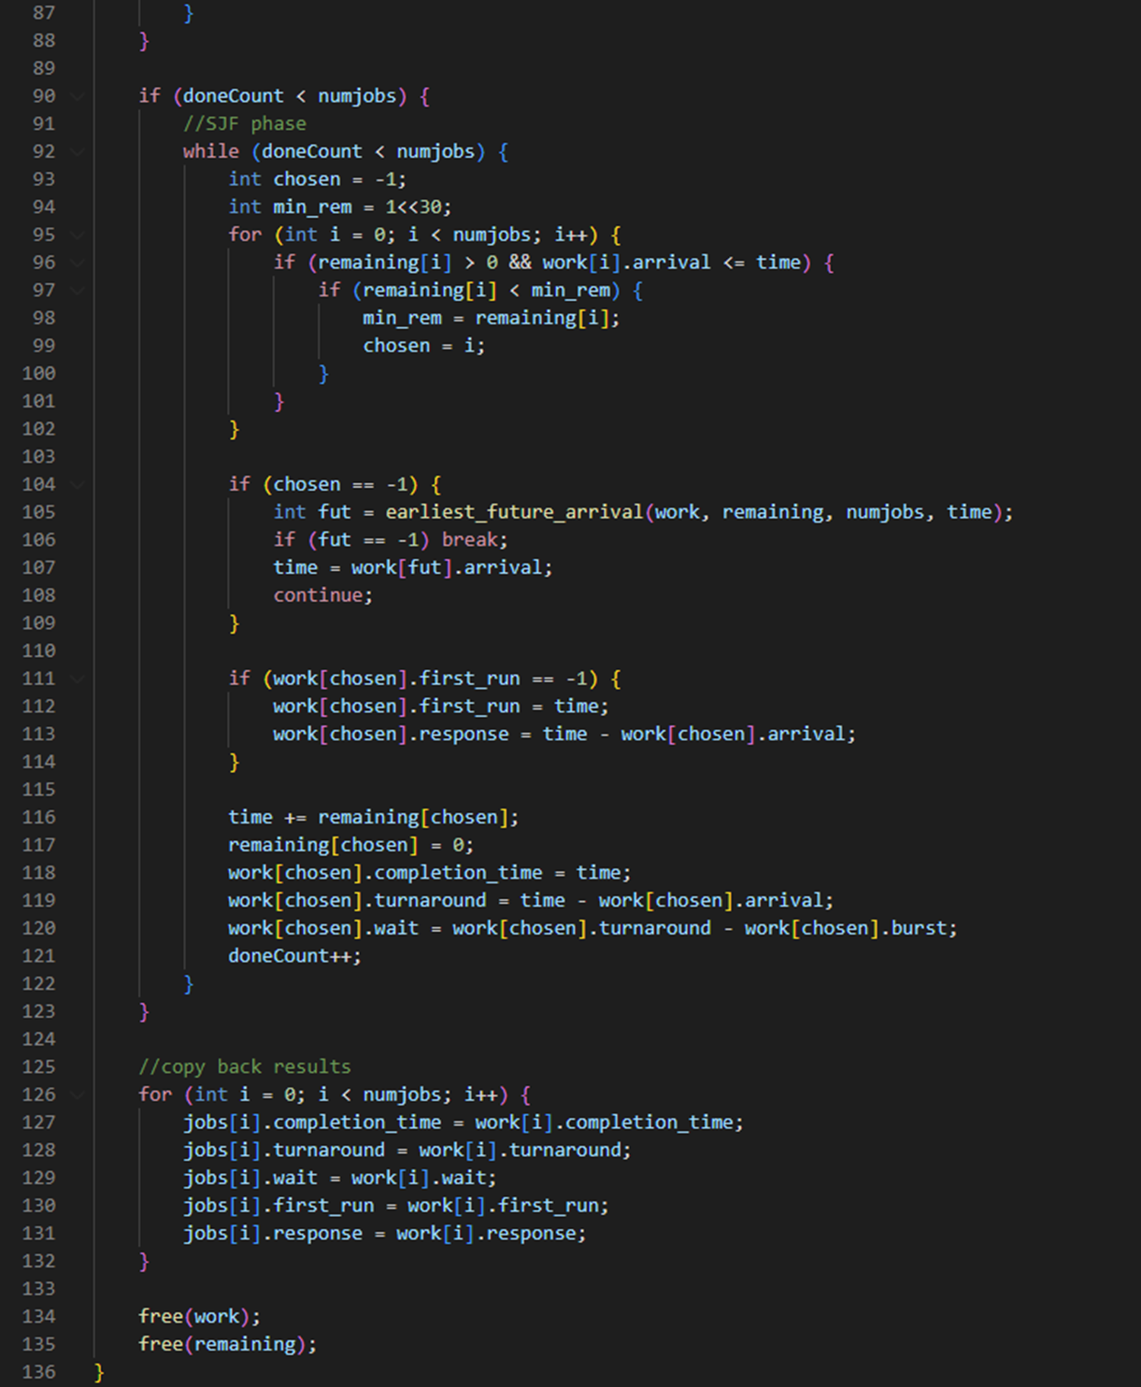
This is our hybrid_quantum() function, which is responsible for implementing and maintaining our hybrid scheduler where we…
Start with FIFO in FIFO.c
Run until a fixed quantum specified expires
Then switch to SJF in SJF.c for the remaining jobs
Quantum.c
A deep dive
This system handles the task of ensuring early jobs are handled predictably in an arrival-order fashion, then when the time window closes, the system will switch to shortest burst time to ensure optimization

Slide 12
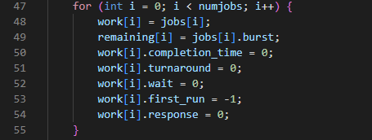
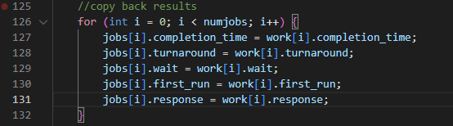
Quantum.c
A deep dive
For our data structures within quantum.c we have the following…
work[]: a local copy of all jobs so the original input isn’t modified or corrupted during the process
remaining[]: keeps track of unfinished burst time of each job

Slide 13
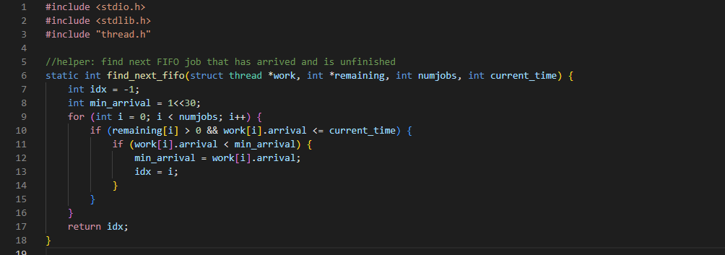

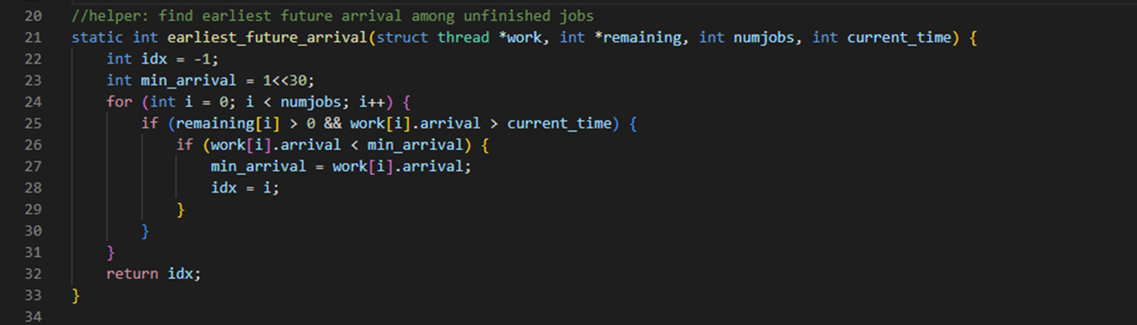
Quantum.c
A deep dive
This helper function find_next_fifo() is used to find the earliest arrival job that has arrived before the current time and is unfinished. This essentially allows the limited FIFO phase to behave like a ready queue processed in arrival order.
earliest_future_arrival() is used for when no job has arrived yet and we need to jump the clock forward to the next arrival. It also prevents CPU idling and correctly simulates scheduler behavior.

Slide 14
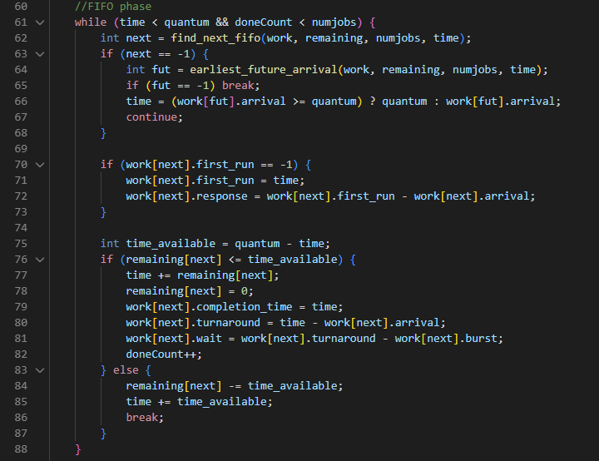
Quantum.c
A deep dive
In the FIFO phase, behavior consists of running only until time < quantum
and in each loop we..
pick the next FIFO job with the helper function find_next_fifo()
then jump to next arrival if none arrived yet
compute response if this is the first time running
then compute the amount of time left in the quantum
lastly, either the job finishes before the quantum or the quantum ends and we must break and switch to SJF

Slide 15
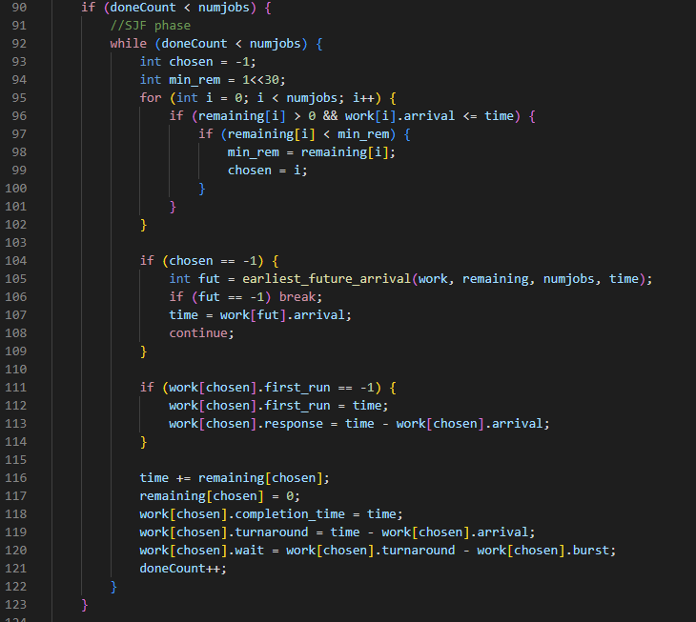
Quantum.c
A deep dive
In the SJF phase, behavior consists of running only for the work that remains after the quantum ends
and in each loop we..
choose the job with the smallest remaining[] time
jump to next arrival if nothing is available
compute response if this is the first run
run job to completion
then update metrics

Slide 16

Turnaround Time
Time from arrival to completion
Let’s say a job arrives at 0ms starts on the CPU at 10ms and completes execution at 15ms.
Turnaround Time = 15ms - 0ms = 15ms
0
10
15

Slide 17
Response Time
Time from arrival of job to start on the CPU
Let’s say a job arrives at 0ms starts on the CPU at 10ms and completes execution at 15ms.
Response Time= 10ms - 0ms = 10ms
0
10
15

Slide 18

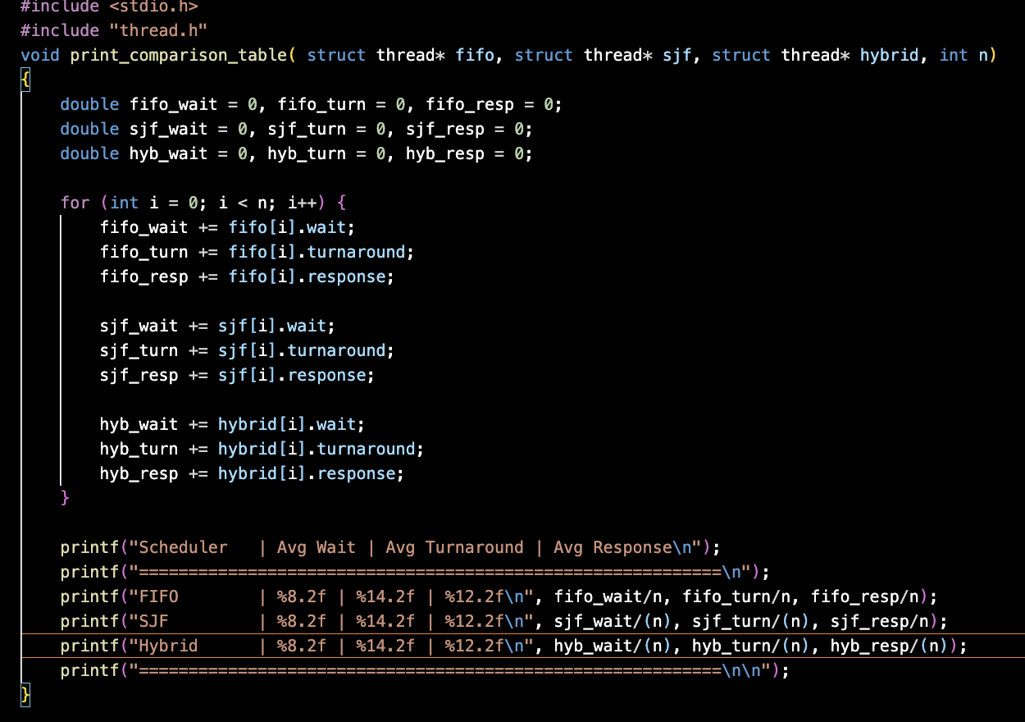
Comparisons
This code gives us the average of wait time, turnaround time, and response time that we see used from the structs that are being used for the schedulers we've implemented. We used this function after calling test cases for our schedulers.

Slide 19
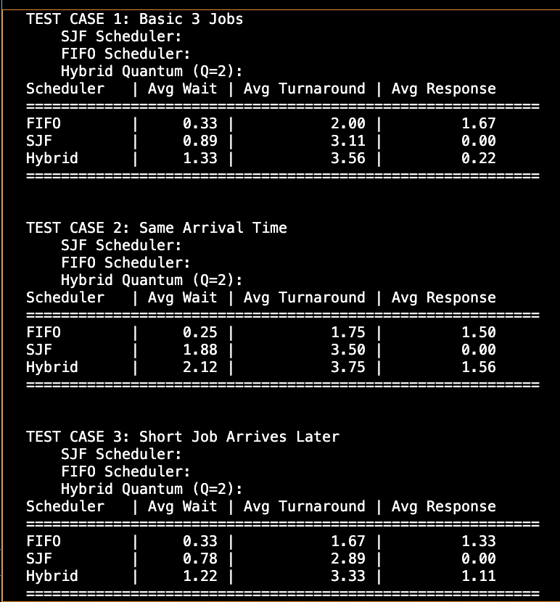
Key Takeaways
As we can see, different schedulers prioritize different goals.
FIFO focuses on simplicity, SJF focuses on minimizing wait time, and our Quantum FIFO to SJF tries to balance both
The hybrid model shows better balance than using FIFO or SJF alone.
It avoids the inefficiency of FIFO and the starvation issues that SJF has, which creates a more fair and responsive scheduler

Slide 20

Future Ideas
Compare More Schedulers
Round Robin
Shortest Job Remaining First
Create a Round Robin scheduler that is FIFO in one Quantum and SJF in the next, continuing until jobs are complete

Slide 21

Thank You For Your Attention! Any Questions?

